Slide 1
Capstone project-1
PREDICTING LOAN DEFAULT RISK
TEAM MEMBERS:-
YASH Goyal(2210992555)
Yash goyal(2210992554)
Yakshit singla(2210992551)
Yash sharma(2210992553)

Slide 2
content
Problem Statement
Objective
Tools Used
EDA(Exploratory Data Analysis)
Challenges
Conclusion

Slide 3
Problem Statement
Financial institutions face significant challenges in assessing the creditworthiness of loan applicants, especially in predicting the likelihood of loan defaults. The ability to accurately identify potential defaulters is crucial for minimizing financial risks and ensuring the stability of lending portfolios. Hence, there is a pressing need for robust predictive models that can efficiently evaluate the default risk associated with loan applicants.
Data analysis on various aspects of a person’s lifestyle is important before assigning loan.
We will be finding out the relationship between various aspects of a person and deciding as to the fact that he/she will default or not.

Slide 4
oBJECTIVE
The objective of this project is to develop a machine learning-based solution for accurately predicting loan default risk. Through the construction of robust predictive models leveraging diverse sets of features, including financial and non-financial data, the project aims to provide lenders with a tool to assess the probability of loan default for individual applicants effectively.

Slide 5
TOOLS USED
Google Collaboratory is used as IDE.
Pandas and NumPy are used for Data Manipulation & Pre-processing and Mathematical functions respectively.
Exploratory data analysis is automated by data prep.
For visualization of the plots, Matplotlib, Seaborn are used.

Slide 6
DATA SUMMARY
NUMERICAL DATA :-
LoanID: Unique identifier for each loan application.
Income: Income of the loan applicant.
LoanAmount: Amount of the loan requested by the applicant.
CreditScore: Credit score of the applicant.
MonthsEmployed: Number of months the applicant has been employed.
NumCreditLines: Number of credit lines the applicant currently has.
InterestRate: Interest rate associated with the loan.
LoanTerm: Term or duration of the loan.
DTIRatio: Debt-to-income ratio of the applicant.

Slide 7
CATEGORICAL DATA :-
Education: Educational level of the applicant.
EmploymentType: Type of employment of the applicant.
MaritalStatus: Marital status of the applicant.
HasMortgage: Indicates whether the applicant has a mortgage.
HasDependents: Indicates whether the applicant has dependents.
LoanPurpose: Purpose of the loan.
HasCoSigner: Indicates whether the loan applicant has a co-signer.

Slide 8
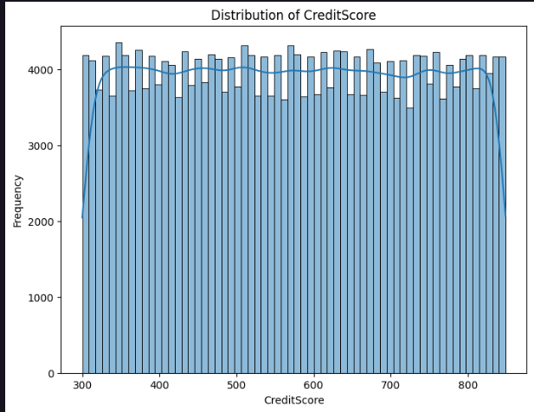
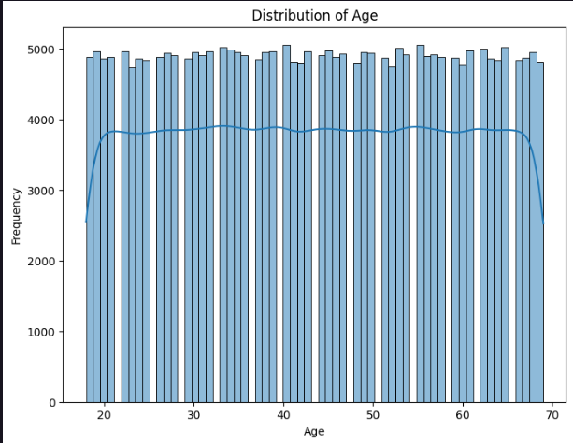
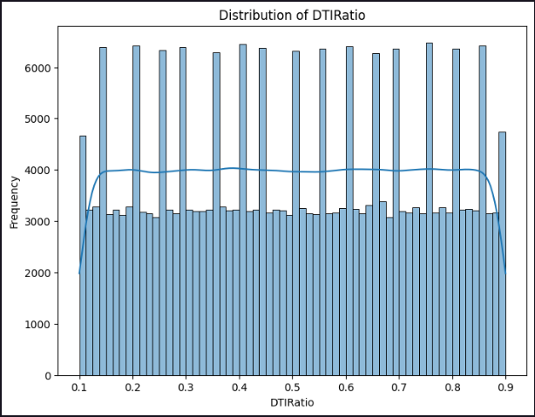
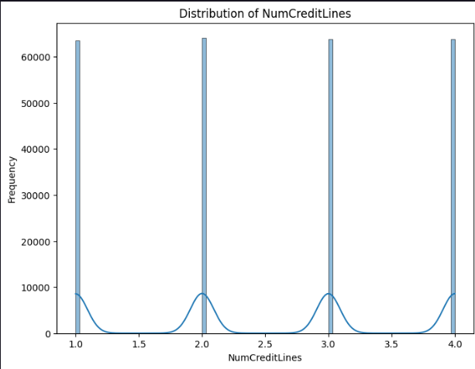
FREQUENCY COUNT OF VARIOUS COLUMNS OF DATASET
These graphs are some examples of how we can use
KDE histograms to provide insights into the
spread, central tendency, and shape of the data
distribution. By visualizing the distribution of each
numerical variable separately, we can identify
potential patterns or anomalies in the data.
CreditScore: The distribution of credit scores can help in understanding the creditworthiness of applicants.
DTIRatio: The debt-to-income ratio distribution can reveal the financial health and leverage of applicants.

Slide 9
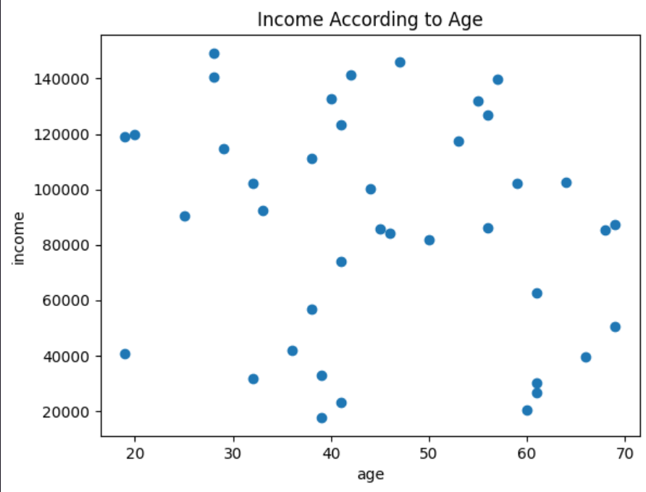
Income according to age
The chart is a scatterplot used to find a relation between income and age of a particular participant.
The insights gained are that We find Income Prediction According to Applicant Age

Slide 10
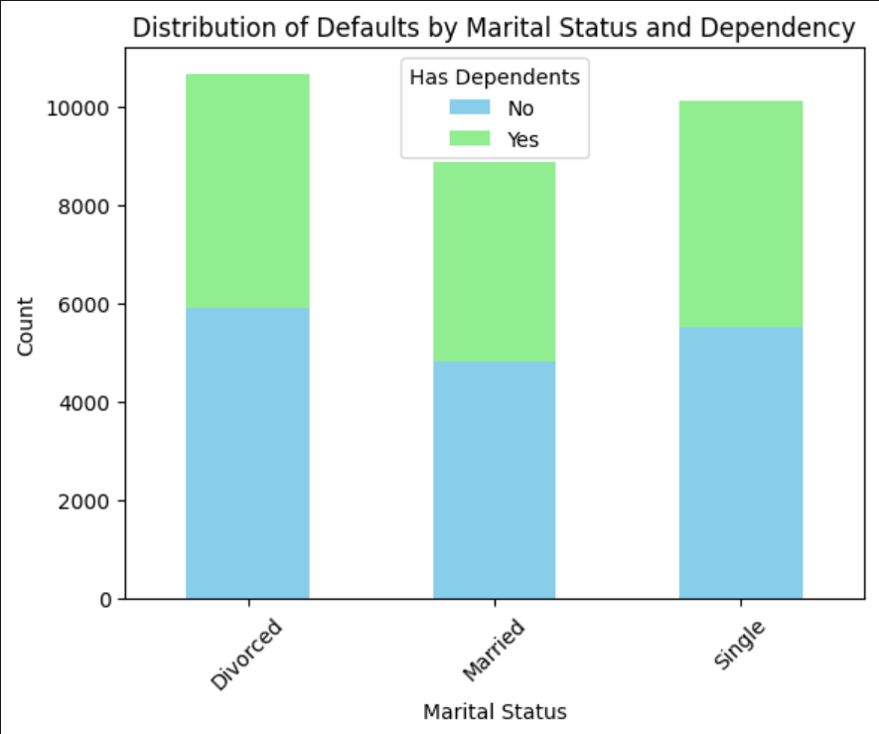
Distribution of Defaults by Marital Status and Dependency
The following chart is stacked bar graph between the marital status and the check if a person has dependents or not.
From the chart, we can observe the distribution of defaults based on marital status and dependency status. Specifically, we can see how defaults are spread across different marital statuses, and within each marital status, how many of the defaulters have dependents and how many do not.

Slide 11
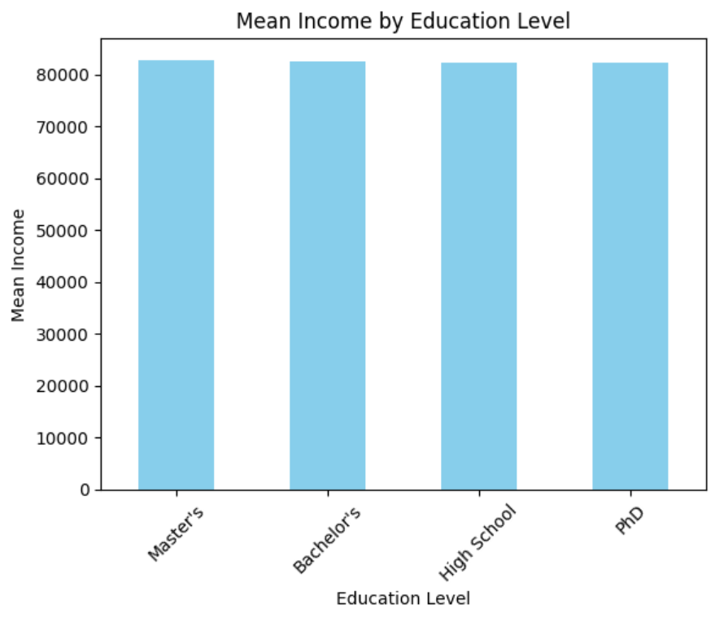
Mean Income by Education Level
The following bar graph depicts the following:-
Identifying the education level associated with the highest mean income. Observing any trends or patterns in income levels as education level increases or decreases.
Comparing the income disparities between different education levels.

Slide 12
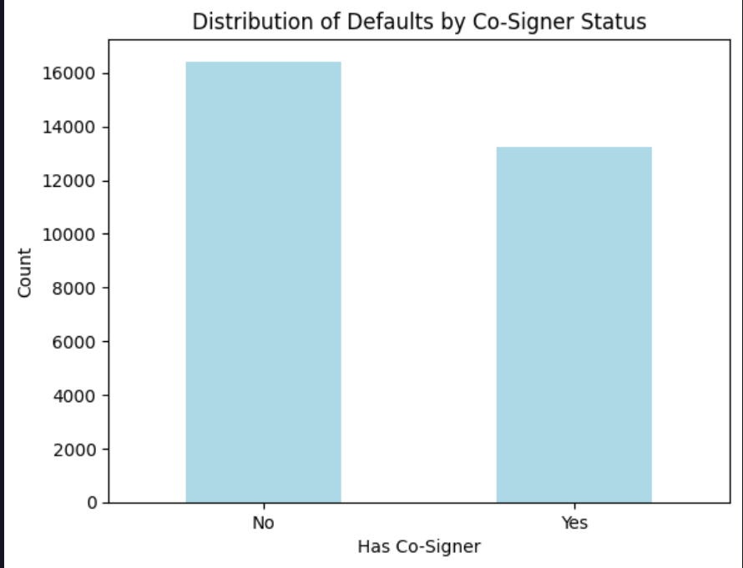
Distribution of Defaults by Co-Signer Status
The insight from the chart is the distribution of defaults based on the presence or absence of a co-signer. By visualizing this data, you can easily see if there's any correlation between having a co-signer and the likelihood of defaulting on a loan.

Slide 13
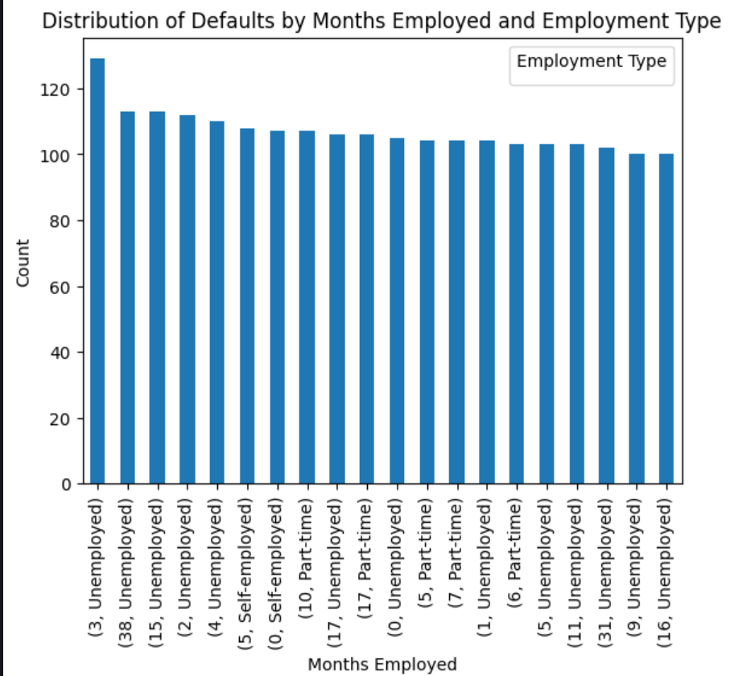
Months employed vs employement type
The chart visually depicts the distribution of defaults across different lengths of employment and employment types. It provides a clear comparison of default counts within each employment type and across different lengths of employment.
The insights can help identify patterns or trends in defaults related to employment tenure and type. This information can inform targeted strategies for risk assessment, loan approvals, or financial product offerings tailored to specific employment categories and lengths of employment

Slide 14
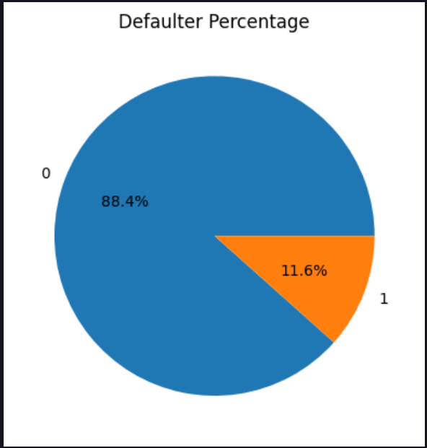
DEFAULTERS VS NON-DEFAULTERS USING PIE CHART
In this case we use a Pie chart to analyse our data.
This helps us get the following information from the graphs:-
The insight from the chart is the percentage breakdown of defaulters versus non-defaulters.
It provides a clear visualization of the proportion of defaulters compared to non-defaulters in the dataset.

Slide 15
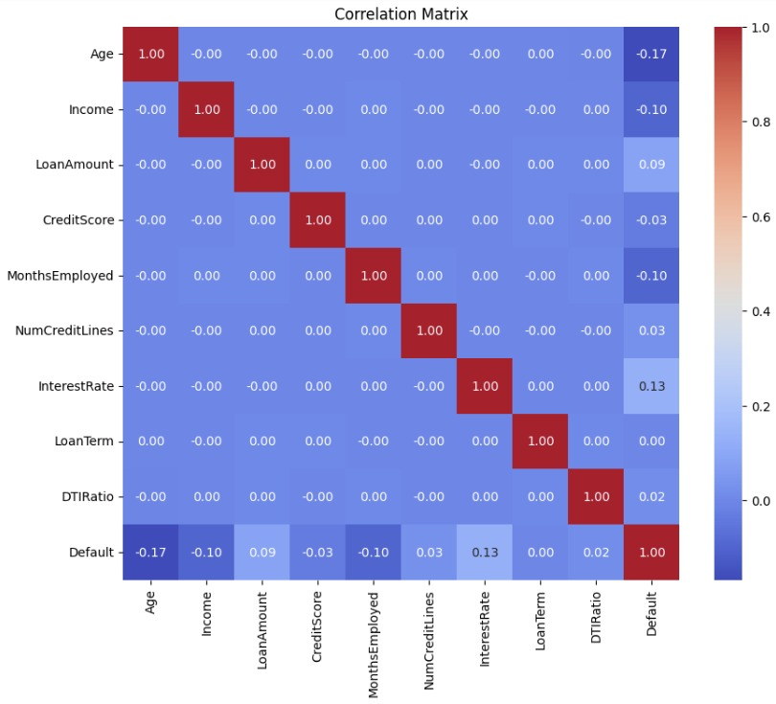
ANALYSIS THROUGH HEATMAP
We used a heatmap of the correlation matrix to effectively visualizes the pairwise correlations between numerical variables in the dataset. Each cell in the heatmap represents the correlation coefficient between two variables, with color indicating the strength and direction of the correlation. Annotating the heatmap with correlation coefficients provides additional information, making it easier to interpret the relationships between variables.

Slide 16
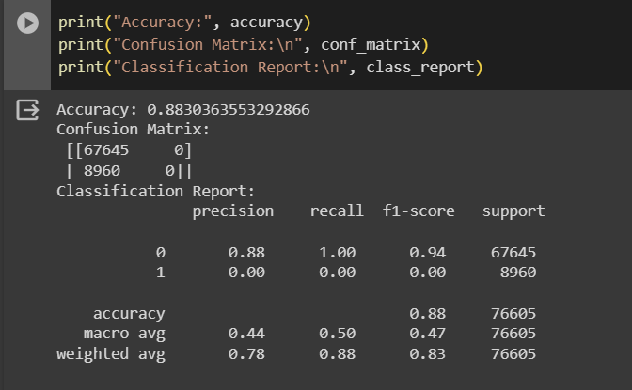
LoGISTIC REGRESSION
Logistic regression is a statistical method used for binary classification tasks, where the outcome variable has two possible values. It models the relationship between a dependent variable and one or more independent variables by estimating the probability that an event occurs. Unlike linear regression, logistic regression predicts the probability of a categorical outcome using a logistic function, which restricts the output between 0 and 1, making it suitable for classification problems.

Slide 17
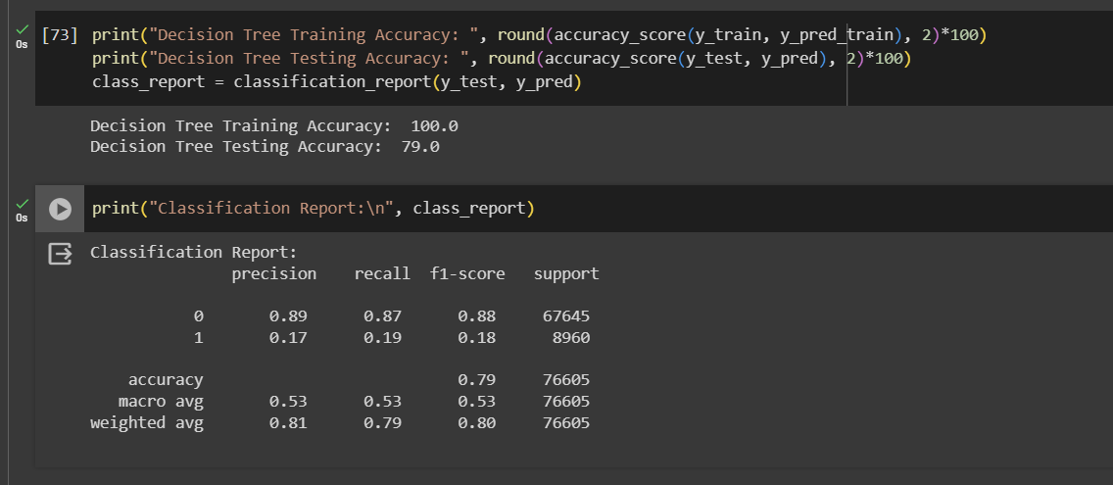
DecISION TREE
A decision tree is a hierarchical model used for both classification and regression tasks in machine learning. It recursively splits the dataset into subsets based on the most significant attribute at each node, creating a tree-like structure where each internal node represents a decision based on an attribute, and each leaf node represents the outcome or prediction. Decision trees are interpretable and intuitive, making them useful for understanding the underlying decision-making process. They can handle both numerical and categorical data, and they're robust against outliers.

Slide 18
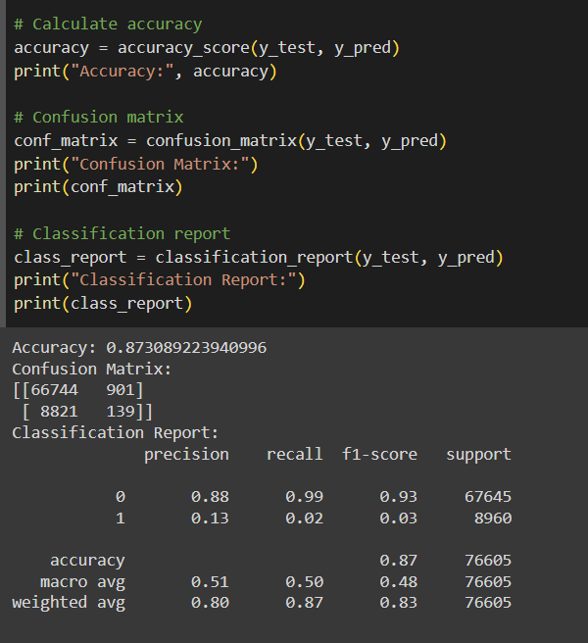
K-nearest neighbours(knn)
K-nearest neighbors (KNN) is a simple yet effective algorithm used for both classification and regression tasks in machine learning. In KNN, the prediction for a new data point is determined by the majority class (for classification) or the average of the values (for regression) of its k nearest neighbors in the feature space. The distance metric, often Euclidean distance, measures the similarity between data points. KNN is non-parametric, meaning it does not assume any underlying probability distribution of the data.

Slide 19
Comparison of all three ml models
The three ML models used in the project are:-
Logistic Regression
Decision Tree
KNN
The accuracy of all the Models can be seen in the screenshots provided.
The accuracy comparison of each model with the other is as follows:-
Logistic>KNN>Decision Tree
88.3>87.4>79.0

Slide 20
Challenges Faced
We faced a lot of difficulties in manipulating such a huge dataset that has a variety of types of data.
Cleaning through the data to get useful information was a problem.
Since the dataset was so large, grouping the most important dataset columns to make a better and efficient visualization for the audience was a challenge.

Slide 21
conclusion
In conclusion, the predictive model developed for assessing loan default risk represents a significant advancement in risk management within the lending industry. By leveraging sophisticated algorithms and extensive datasets, the model demonstrates promising accuracy in identifying potential defaulters, thereby enabling lenders to make more informed decisions regarding loan approvals. This project underscores the importance of leveraging data-driven approaches to mitigate financial risks and optimize lending practices.

